Slide 1
Given an image of a ball,
can you predict where it will go next?

Slide 2
Given an image of a ball,
can you predict where it will go next?
???

Slide 3
Given an image of a ball,
can you predict where it will go next?

Slide 4
Given an image of a ball,
can you predict where it will go next?

Slide 5
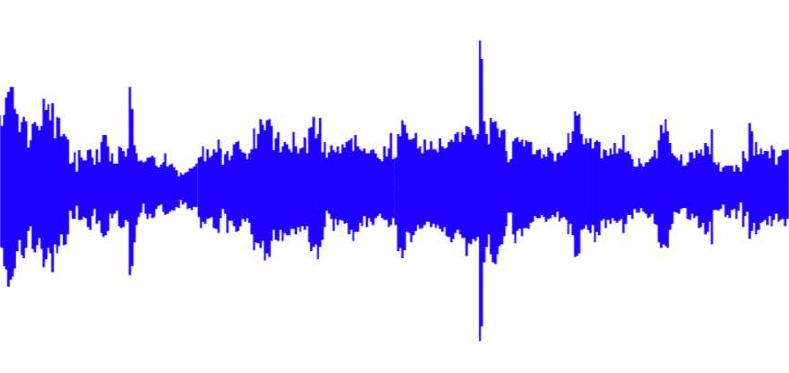
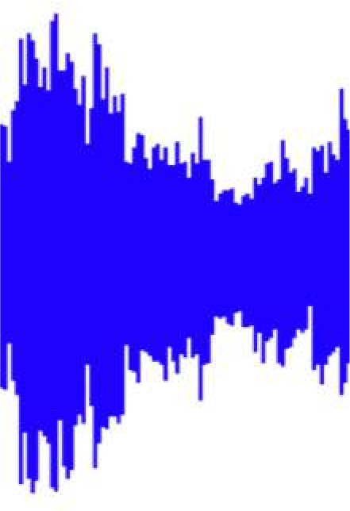
Sequences in the wild
Audio

Slide 6
Sequences in the wild
character:
Introduction to Deep Learning
word:
Text

Slide 7
A Sequence Modeling Problem: Predict the Next Word

Slide 8
A sequence modeling problem: predict the next word
“This morning I took my cat for a walk.”

Slide 9
A sequence modeling problem: predict the next word
“This morning I took my cat for a
walk.”
given these words

Slide 10
A sequence modeling problem: predict the next word
“This morning I took my cat for a
walk.”
given these words
predict the next word
Adapted from H. Suresh, 6.S191 2018

Slide 11
Idea #1: use a fixed window
“This morning I took my cat
for a
walk.”
given these two words
predict the next word

Slide 12
Idea #1: use a fixed window
“This morning I took my cat
for a
walk.”
given these two words
predict the next word
One-hot feature encoding: tells us what each word is
[ 1 0 0 0 0 0 1 0 0 0 ]
for a
prediction

Slide 13
Problem #1: can’t model long-term dependencies
“France is where I grew up, but I now live in Boston. I speak fluent ___.”
J’aime France!
We need information from the distant past to accurately predict the correct word.

Slide 14
Idea #2: use entire sequence as set of counts
“This morning I took my cat for a”
“bag of words”
[ 0 1 0 0 1 0 0 … 0 0 1 1 0 0 0 1]
prediction

Slide 15


Problem #2: counts don’t preserve order
The food was good, not bad at all.
vs.
The food was bad, not good at all.

Slide 16
Idea #3: use a really big fixed window
“This morning I took my cat
for a
walk.”
given these two words
predict the next word
[ 1 0 0 0 0 0 0 0 0 1 0 0 1 0 0 0 1 0 0 0 0 0 0 1 0 … ]
morning I took this cat
prediction

Slide 17
Problem #3: no parameter sharing
[ 1 0 0 0 0 0 0 0 0 1 0 0 1 0 0 0 1 0 0 0 0 0 0 1 0 … ]
this morning took the cat
Each of these inputs has a separate parameter:

Slide 18
Problem #3: no parameter sharing
[ 1 0 0 0 0 0 0 0 0 1 0 0 1 0 0 0 1 0 0 0 0 0 0 1 0 … ]
this morning took the cat
Each of these inputs has a separate parameter:
[0 0 0 1 0 0 0 1 0 0 0 1 0 0 0 1 0 0 0 0 0 0 0 0 1 … ]
this morning

Slide 19
Problem #3: no parameter sharing
[ 1 0 0 0 0 0 0 0 0 1 0 0 1 0 0 0 1 0 0 0 0 0 0 1 0 … ]
this morning took the cat
Each of these inputs has a separate parameter:
[0 0 0 1 0 0 0 1 0 0 0 1 0 0 0 1 0 0 0 0 0 0 0 0 1 … ]
this morning
Things we learn about the sequence won’t transfer if they appear elsewhere in the sequence.

Slide 20
Sequence modeling: design criteria
To model sequences, we need to:
Handle variable-length sequences
Track long-term dependencies
Maintain information about order
Share parameters across the sequence
RNN
Today: Recurrent Neural Networks (RNNs) as an approach to sequence modeling problems

Slide 21
Recurrent Neural Networks (RNNs)

Slide 22

Standard feed-forward neural network
𝑦"
𝑥
One to One “Vanilla” neural network

Slide 23
Recurrent neural networks: sequence modeling
𝑦"
𝑥
One to One “Vanilla” neural network
Many to One
Sentiment Classification

Slide 24
Recurrent neural networks: sequence modeling
𝑦"
𝑥
One to One
“Vanilla” neural network
Many to One
Sentiment Classification
Many to Many
Music Generation

Slide 25
Recurrent neural networks: sequence modeling
𝑦"
… and many other architectures and applications
𝑥
One to One
“Vanilla” neural network
Many to One
Sentiment Classification
Many to Many
Music Generation

Slide 26
A standard “vanilla” neural network
output vector
𝑦#_{𝑡}
input vector
𝑥_{𝑡}

Slide 27
A recurrent neural network (RNN)
output vector
RNN
ℎ_{𝑡}
input vector
𝑥_{𝑡}

Slide 28
A recurrent neural network (RNN)
output vector
𝑦#_{𝑡}
RNN
ℎ_{𝑡}
recurrent cell
input vector
𝑥_{𝑡}

Slide 29
A recurrent neural network (RNN)
output vector
𝑦#_{𝑡}
Apply a recurrence relation at every time step to process a sequence:
RNN
ℎ_{𝑡}
recurrent cell
input vector
𝑥_{𝑡}

Slide 30
A recurrent neural network (RNN)
output vector
𝑦,_{𝑡}
Apply a recurrence relation at every time step to process a sequence:
ℎ_{𝑡} = 𝑓_{𝖶} (ℎ_{𝑡-1}, 𝑥_{𝑡})
RNN
cell state
function parameterized by W
old state
input vector at time step t
ℎ
recurrent cell
𝑡
input vector
𝑥_{𝑡}

Slide 31
A recurrent neural network (RNN)
output vector
𝑦,_{𝑡}
Apply a recurrence relation at every time step to process a sequence:
ℎ_{𝑡} = 𝑓_{𝖶} (ℎ_{𝑡-1}, 𝑥_{𝑡})
RNN
new state
function parameterized by W
old state
input vector at time step t
ℎ
recurrent cell
𝑡
Note: the same function and set of parameters are used at every time step
input vector
𝑥_{𝑡}

Slide 32
RNN state update and output
output vector
𝑦#_{𝑡}
RNN
ℎ_{𝑡}
recurrent cell
input vector
𝑥_{𝑡}

Slide 33
RNN state update and output
output vector
𝑦#_{𝑡}
RNN
ℎ_{𝑡}
recurrent cell
input vector
𝑥_{𝑡}
Input Vector

Slide 34
RNN state update and output
output vector
𝑦1_{𝑡}
Update Hidden State
ℎ_{𝑡} = tanh(W_{ℎℎ}ℎ_{𝑡–1} + W_{𝑥ℎ}𝑥_{𝑡})
RNN
ℎ_{𝑡}
recurrent cell
input vector
𝑥_{𝑡}
Input Vector

Slide 35

RNN state update and output
Output Vector
𝑦1_{𝑡} = W_{ℎ𝑦}ℎ_{𝑡}
Update Hidden State
ℎ_{𝑡} = tanh(W_{ℎℎ}ℎ_{𝑡–1} + W_{𝑥ℎ}𝑥_{𝑡})
output vector
𝑦1_{𝑡}
RNN
ℎ_{𝑡}
recurrent cell
input vector
𝑥_{𝑡}
Input Vector

Slide 36

RNNs: computational graph across time
𝑦#_{𝑡}
=
RNN
Represent as computational graph unrolled across time
𝑥_{𝑡}

Slide 37
RNNs: computational graph across time
𝑦^_{𝑡}
𝑦^₀
=
RNN
𝑥_{𝑡}
𝑥₀

Slide 38
RNNs: computational graph across time
𝑦^_{𝑡}
𝑦^₀
𝑦^₁
=
RNN
𝑥_{𝑡}
𝑥₀
𝑥₁

Slide 39
RNNs: computational graph across time
…
𝑦^_{𝑡}
𝑦^₀
𝑦^₁
𝑦^₂
𝑦^_{𝑡}
=
RNN
…
𝑥_{𝑡}
𝑥₀
𝑥₁
𝑥₂
𝑥_{𝑡}

Slide 40
RNNs: computational graph across time
…
𝑦^_{𝑡}
𝑦^₀
𝑦^₁
𝑦^₂
𝑦^_{𝑡}
=
RNN
^{𝘸}𝑥ℎ
𝑥₀
^{𝘸}𝑥ℎ
𝑥₁
^{𝘸}𝑥ℎ
𝑥₂
^{𝘸}𝑥ℎ
𝑥_{𝑡}
…
𝑥_{𝑡}

Slide 41
RNNs: computational graph across time
…
𝑦^_{𝑡}
𝑦^₀
𝑦^₁
𝑦^₂
𝑦^_{𝑡}
=
RNN
^{𝘸}ℎℎ
^{𝘸}ℎℎ
^{𝘸}ℎℎ
^{𝘸}𝑥ℎ
𝑥₀
^{𝘸}𝑥ℎ
𝑥₁
^{𝘸}𝑥ℎ
𝑥₂
^{𝘸}𝑥ℎ
𝑥_{𝑡}
…
𝑥_{𝑡}

Slide 42
RNNs: computational graph across time
…
𝑦^_{𝑡}
𝑦^₀
^{𝘸}ℎ𝑦
𝑦^₁
^{𝘸}ℎ𝑦
𝑦^₂
^{𝘸}ℎ𝑦
𝑦^_{𝑡}
^{𝘸}ℎ𝑦
=
RNN
^{𝘸}ℎℎ
^{𝘸}ℎℎ
^{𝘸}ℎℎ
^{𝘸}𝑥ℎ
𝑥₀
^{𝘸}𝑥ℎ
𝑥₁
^{𝘸}𝑥ℎ
𝑥₂
^{𝘸}𝑥ℎ
𝑥_{𝑡}
…
𝑥_{𝑡}

Slide 43
RNNs: computational graph across time
Re-use the same weight matrices at every time step
…
𝑦^_{𝑡}
𝑦^₀
^{𝘸}ℎ𝑦
𝑦^₁
^{𝘸}ℎ𝑦
𝑦^₂
^{𝘸}ℎ𝑦
𝑦^_{𝑡}
^{𝘸}ℎ𝑦
=
RNN
^{𝘸}ℎℎ
^{𝘸}ℎℎ
^{𝘸}ℎℎ
^{𝘸}𝑥ℎ
𝑥₀
^{𝘸}𝑥ℎ
𝑥₁
^{𝘸}𝑥ℎ
𝑥₂
^{𝘸}𝑥ℎ
𝑥_{𝑡}
…
𝑥_{𝑡}

Slide 44
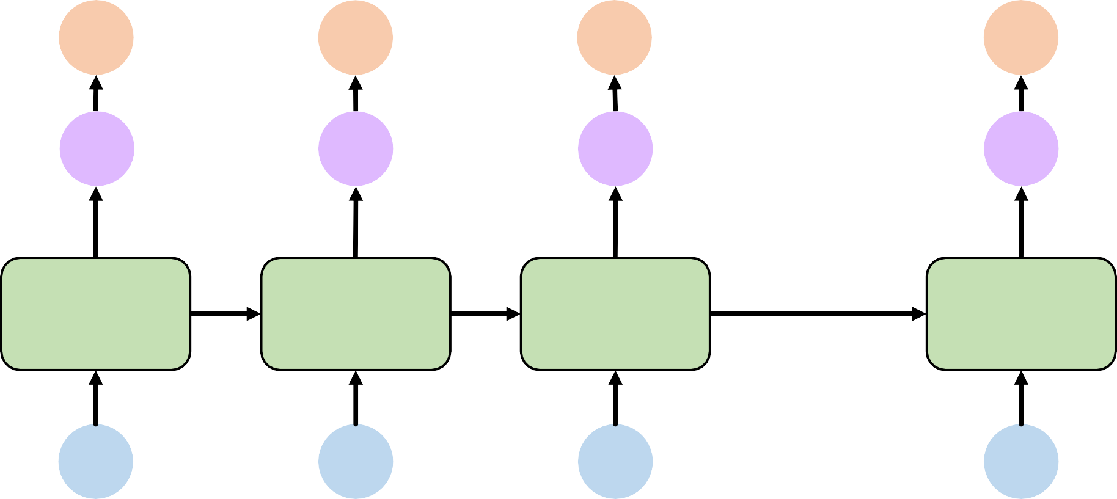
RNNs: computational graph across time
Forward pass
𝐿₀
𝐿₁
𝐿₂
𝐿₃
…
𝑦^_{𝑡}
𝑦^₀
^{𝘸}ℎ𝑦
𝑦^₁
^{𝘸}ℎ𝑦
𝑦^₂
^{𝘸}ℎ𝑦
𝑦^_{𝑡}
^{𝘸}ℎ𝑦
=
RNN
^{𝘸}ℎℎ
^{𝘸}ℎℎ
^{𝘸}ℎℎ
^{𝘸}𝑥ℎ
𝑥₀
^{𝘸}𝑥ℎ
𝑥₁
^{𝘸}𝑥ℎ
𝑥₂
^{𝘸}𝑥ℎ
𝑥_{𝑡}
…
𝑥_{𝑡}

Slide 45
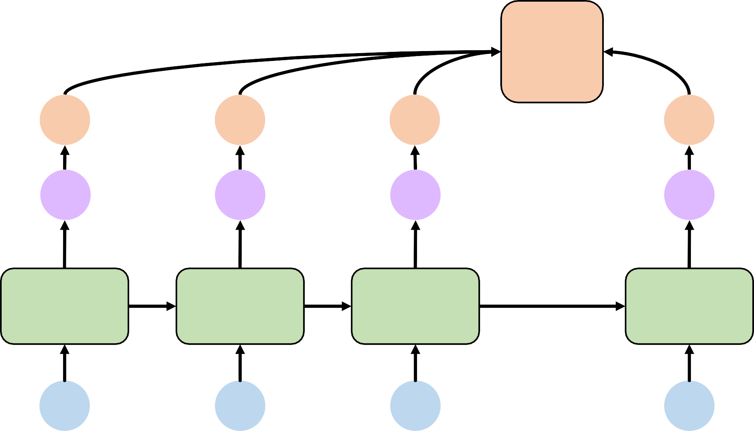
𝐿
RNNs: computational graph across time
Forward pass
𝐿₀
𝐿₁
𝐿₂
𝐿₃
…
𝑦^_{𝑡}
𝑦^₀
^{𝘸}ℎ𝑦
𝑦^₁
^{𝘸}ℎ𝑦
𝑦^₂
^{𝘸}ℎ𝑦
𝑦^_{𝑡}
^{𝘸}ℎ𝑦
=
RNN
^{𝘸}ℎℎ
^{𝘸}ℎℎ
^{𝘸}ℎℎ
^{𝘸}𝑥ℎ
𝑥₀
^{𝘸}𝑥ℎ
𝑥₁
^{𝘸}𝑥ℎ
𝑥₂
^{𝘸}𝑥ℎ
𝑥_{𝑡}
…
𝑥_{𝑡}

Slide 46
Backpropagation Through Time (BPTT)

Slide 47
Recall: backpropagation in feed forward models
𝑦
Backpropagation algorithm:
Take the derivative (gradient) of the loss with respect to each parameter
Shift parameters in order to minimize loss
𝑥

Slide 48

𝐿
RNNs: backpropagation through time
Forward pass
𝐿₀
𝐿₁
𝐿₂
𝐿₃
…
𝑦^_{𝑡}
𝑦^₀
^{𝘸}ℎ𝑦
𝑦^₁
^{𝘸}ℎ𝑦
𝑦^₂
^{𝘸}ℎ𝑦
𝑦^_{𝑡}
^{𝘸}ℎ𝑦
=
RNN
^{𝘸}ℎℎ
^{𝘸}ℎℎ
^{𝘸}ℎℎ
^{𝘸}𝑥ℎ
𝑥₀
^{𝘸}𝑥ℎ
𝑥₁
^{𝘸}𝑥ℎ
𝑥₂
^{𝘸}𝑥ℎ
𝑥_{𝑡}
…
𝑥_{𝑡}

Slide 49
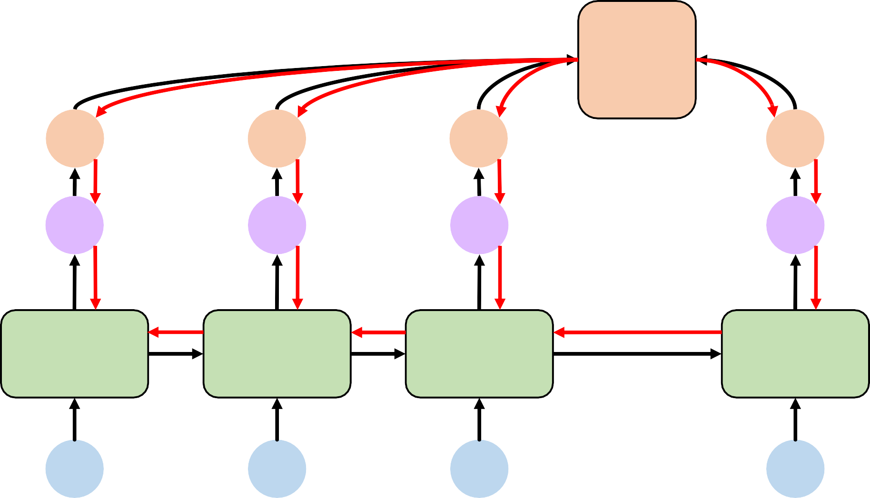
𝐿
RNNs: backpropagation through time
Forward pass
Backward pass
𝐿₀
𝐿₁
𝐿₂
𝐿₃
…
𝑦^_{𝑡}
𝑦^₀
^{𝘸}ℎ𝑦
𝑦^₁
^{𝘸}ℎ𝑦
𝑦^₂
^{𝘸}ℎ𝑦
𝑦^_{𝑡}
^{𝘸}ℎ𝑦
=
RNN
^{𝘸}ℎℎ
^{𝘸}ℎℎ
^{𝘸}ℎℎ
^{𝘸}𝑥ℎ
𝑥₀
^{𝘸}𝑥ℎ
𝑥₁
^{𝘸}𝑥ℎ
𝑥₂
^{𝘸}𝑥ℎ
𝑥_{𝑡}
…
𝑥_{𝑡}

Slide 50
Standard RNN gradient flow
ℎ₀
^{𝘸}𝑥ℎ
𝑥₀
ℎ_{𝑡}
^{𝘸}𝑥ℎ
𝑥_{𝑡}
^{𝘸}ℎℎ
^{𝘸}ℎℎ
^{𝘸}ℎℎ
^{𝘸}𝑥ℎ
𝑥₁
^{𝘸}𝑥ℎ
𝑥₂
…

Slide 51
Standard RNN gradient flow
ℎ₀
^{𝘸}𝑥ℎ
𝑥₀
ℎ_{𝑡}
^{𝘸}𝑥ℎ
𝑥_{𝑡}
^{𝘸}ℎℎ
^{𝘸}ℎℎ
^{𝘸}ℎℎ
^{𝘸}𝑥ℎ
𝑥₁
^{𝘸}𝑥ℎ
𝑥₂
…
Computing the gradient wrt ℎ₀ involves many factors of W_{ℎℎ} (and repeated 𝑓′!)

Slide 52
Standard RNN gradient flow: exploding gradients
ℎ₀
^{𝘸}𝑥ℎ
𝑥₀
ℎ_{𝑡}
^{𝘸}𝑥ℎ
𝑥_{𝑡}
^{𝘸}ℎℎ
^{𝘸}ℎℎ
^{𝘸}ℎℎ
^{𝘸}𝑥ℎ
𝑥₁
^{𝘸}𝑥ℎ
𝑥₂
…
Computing the gradient wrt ℎ₀ involves many factors of W_{ℎℎ} (and repeated 𝑓′!)
Many values > 1:
exploding gradients

Slide 53
Standard RNN gradient flow: exploding gradients
ℎ₀
^{𝘸}𝑥ℎ
𝑥₀
ℎ_{𝑡}
^{𝘸}𝑥ℎ
𝑥_{𝑡}
^{𝘸}ℎℎ
^{𝘸}ℎℎ
^{𝘸}ℎℎ
^{𝘸}𝑥ℎ
𝑥₁
^{𝘸}𝑥ℎ
𝑥₂
…
Computing the gradient wrt ℎ₀ involves many factors of W_{ℎℎ} (and repeated 𝑓′!)
Many values > 1:
exploding gradients
Gradient clipping to scale big gradients

Slide 54
Standard RNN gradient flow: vanishing gradients
ℎ₀
^{𝘸}𝑥ℎ
𝑥₀
ℎ_{𝑡}
^{𝘸}𝑥ℎ
𝑥_{𝑡}
^{𝘸}ℎℎ
^{𝘸}ℎℎ
^{𝘸}ℎℎ
^{𝘸}𝑥ℎ
𝑥₁
^{𝘸}𝑥ℎ
𝑥₂
…
Computing the gradient wrt ℎ₀ involves many factors of W_{ℎℎ} (and repeated 𝑓′!)
Many values > 1:
exploding gradients
Gradient clipping to scale big gradients
Many values < 1:
vanishing gradients

Slide 55
Standard RNN gradient flow: vanishing gradients
ℎ₀
^{𝘸}𝑥ℎ
𝑥₀
ℎ_{𝑡}
^{𝘸}𝑥ℎ
𝑥_{𝑡}
^{𝘸}ℎℎ
^{𝘸}ℎℎ
^{𝘸}ℎℎ
^{𝘸}𝑥ℎ
𝑥₁
^{𝘸}𝑥ℎ
𝑥₂
…
Computing the gradient wrt ℎ₀ involves many factors of W_{ℎℎ} (and repeated 𝑓′!)
Largest singular value > 1:
exploding gradients
Gradient clipping to scale big gradients
Largest singular value < 1:
vanishing gradients
Activation function
Weight initialization
Network architecture

Slide 56
The problem of long-term dependencies
Why are vanishing gradients a problem?

Slide 57
The problem of long-term dependencies
Why are vanishing gradients a problem?
Multiply many small numbers together

Slide 58
The problem of long-term dependencies
Why are vanishing gradients a problem?
Multiply many small numbers together
Errors due to further back time steps have smaller and smaller gradients

Slide 59
The problem of long-term dependencies
Why are vanishing gradients a problem?
Multiply many small numbers together
Errors due to further back time steps have smaller and smaller gradients
Bias network to capture short-term dependencies

Slide 60
The problem of long-term dependencies
“The clouds are in the ”
Why are vanishing gradients a problem?
Multiply many small numbers together
Errors due to further back time steps have smaller and smaller gradients
Bias network to capture short-term dependencies

Slide 61

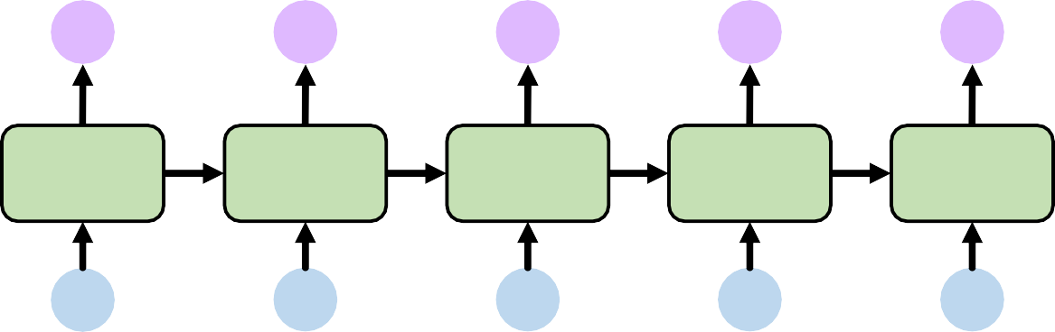


The problem of long-term dependencies
“The clouds are in the ”
Why are vanishing gradients a problem?
𝑦^₀ 𝑦^₁ 𝑦^₂ 𝑦^₃
𝑦^₄
Multiply many small numbers together
Errors due to further back time steps have smaller and smaller gradients
𝑥₀
𝑥₁
𝑥₂
𝑥₃
𝑥₄
Bias parameters to capture short-term dependencies

Slide 62
The problem of long-term dependencies
“The clouds are in the ”
Why are vanishing gradients a problem?
𝑦^₀ 𝑦^₁ 𝑦^₂ 𝑦^₃
𝑦^₄
Multiply many small numbers together
Errors due to further back time steps have smaller and smaller gradients
𝑥₀
𝑥₁
𝑥₂
𝑥₃
𝑥₄
“I grew up in France, … and I l speak fluent ”
Bias parameters to capture short-term dependencies

Slide 63



The problem of long-term dependencies
“The clouds are in the ”
Why are vanishing gradients a problem?
𝑦^₀ 𝑦^₁ 𝑦^₂ 𝑦^₃
𝑦^₄
Multiply many small numbers together
Errors due to further back time steps have smaller and smaller gradients
𝑥₀
𝑥₁
𝑥₂
𝑥₃
𝑥₄
“I grew up in France, … and I l speak fluent ”
… 𝑦^_{𝑡}
𝑦^₀
𝑦^₁
^{𝑦^}𝑡+1
Bias parameters to capture short-term dependencies
…
𝑥₀
𝑥₁
𝑥_{𝑡}
^{𝑥}𝑡+1

Slide 64
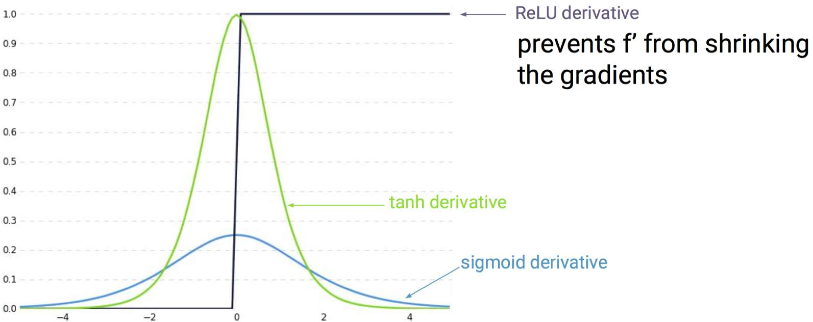
Trick #1: activation functions
ReLU derivative
Using ReLU prevents
𝑓"from shrinking the gradients when 𝑥 > 0
tanh derivative
sigmoid derivative

Slide 65
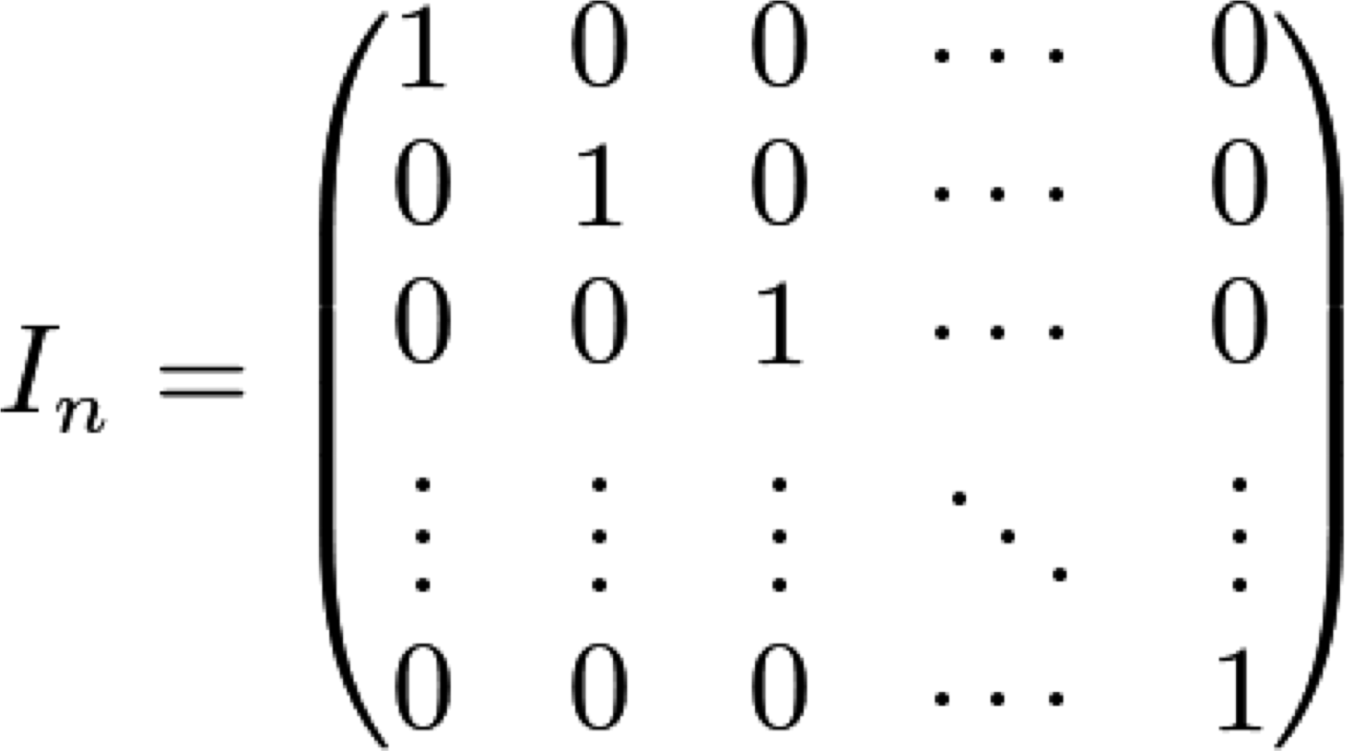
Trick #2: parameter initialization
Initialize weights to identity matrix
Initialize biases to zero
This helps prevent the weights from shrinking to zero.

Slide 66
Solution #3: gated cells
Idea: use a more complex recurrent unit with gates to control what information is passed through
gated cell
LSTM, GRU, etc.

Slide 67
Solution #3: gated cells
Idea: use a more complex recurrent unit with gates to control what information is passed through
gated cell
LSTM, GRU, etc.
Long Short Term Memory (LSTMs) networks rely on a gated cell to track information throughout many time steps.

Slide 68
Long Short Term Memory (LSTM) Networks

Slide 69
Standard RNN
In a standard RNN, repeating modules contain a simple computation node
^{ℎ}𝑡−1
tanh
^{𝑥}𝑡−1
ℎ_{𝑡}
^{ℎ}𝑡+1
tanh
^{𝑥}𝑡+1
tanh
𝑥_{𝑡}

Slide 70
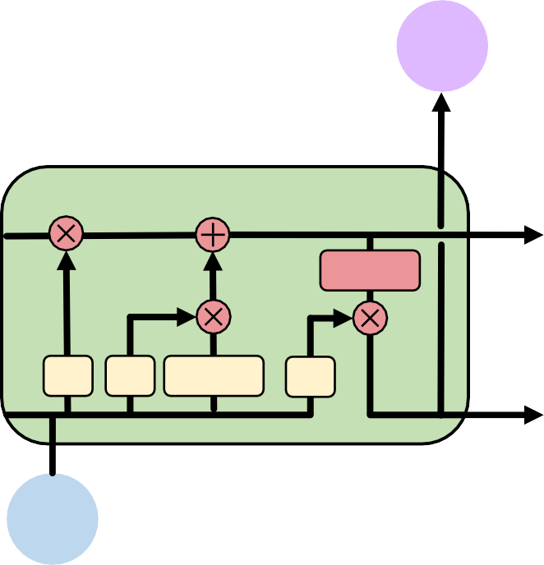


Long Short Term Memory (LSTMs)
LSTM repeating modules contain interacting layers that control information flow
^{ℎ}𝑡–1
tanh
𝝈 𝝈 tanh 𝝈
^{𝑥}𝑡–1
ℎ_{𝑡}
^{ℎ}𝑡+1
tanh
𝝈 𝝈 tanh 𝝈
^{𝑥}𝑡+1
tanh
𝝈 𝝈
tanh
𝝈
𝑥_{𝑡}
LSTM cells are able to track information throughout many timesteps

Slide 71


Long Short Term Memory (LSTMs)
LSTMs maintain a cell state 𝑐_{𝑡} where it’s easy for information to flow
ℎ_{𝑡}
tanh
𝝈 𝝈 tanh 𝝈
^{ℎ}𝑡$1 ^{ℎ}𝑡
𝑥_{𝑡}
^{𝑐}𝑡$1
𝑐_{𝑡}

Slide 72
Long Short Term Memory (LSTMs)
Information is added or removed to cell state through structures called gates
𝝈
Gates optionally let information through, via a sigmoid neural net layer and pointwise multiplication

Slide 73


Long Short Term Memory (LSTMs)
How do LSTMs work?
ℎ_{𝑡}
^{𝑐}𝑡–1
𝑐_{𝑡}
tanh
𝑓_{𝑡}
𝝈 𝝈
tanh
𝝈
^{ℎ}𝑡–1
ℎ_{𝑡}
𝑥_{𝑡}

Slide 74
Long Short Term Memory (LSTMs)
LSTMs forget irrelevant parts of the previous state
ℎ_{𝑡}
^{𝑐}𝑡–1 ^{𝑐}𝑡
tanh
𝝈 tanh 𝝈
ℎ_{𝑡}
𝑓_{𝑡}
𝝈
^{ℎ}𝑡–1
𝑥_{𝑡}

Slide 75
Long Short Term Memory (LSTMs)
LSTMs selectively update cell state values
ℎ_{𝑡}
tanh
𝝈 𝝈 tanh 𝝈
ℎ_{𝑡}
^{𝑐}𝑡–1
𝑐_{𝑡}
^{ℎ}𝑡–1
𝑥_{𝑡}

Slide 76


Long Short Term Memory (LSTMs)
LSTMs use an output gate to output certain parts of the cell state
ℎ_{𝑡}
^{𝑐}𝑡–1 ^{𝑐}𝑡
𝝈 𝝈 tanh
tanh
𝑜_{𝑡}
𝝈
^{ℎ}𝑡–1
ℎ_{𝑡}
𝑥_{𝑡}

Slide 77
Long Short Term Memory (LSTMs)
How do LSTMs work?
1) Forget 2) Update 3) Output
ℎ_{𝑡}
^{𝑐}𝑡–1
𝑐_{𝑡}
tanh
𝑓_{𝑡}
𝝈 𝝈
tanh
𝝈
^{ℎ}𝑡–1
ℎ_{𝑡}
𝑥_{𝑡}

Slide 78
LSTMs: forget irrelevant information
ℎ_{𝑡}
^{𝑐}𝑡–1 ^{𝑐}𝑡
tanh
𝝈 tanh 𝝈
ℎ_{𝑡}
𝑓_{𝑡} = 𝜎(W_{𝑖} + 𝑏_{𝑓} )
^{ℎ}𝑡–1^{, 𝑥}𝑡
Use previous cell output and input
Sigmoid: value 0 and 1 – “completely forget” vs. “completely keep”
𝑓_{𝑡}
𝝈
^{ℎ}𝑡–1
𝑥_{𝑡}
ex: Forget the gender pronoun of previous subject in sentence.

Slide 79
LSTMs: identify new information to be stored
ℎ_{𝑡}
^{𝑐}𝑡–1 ^{𝑐}𝑡
tanh
𝝈 𝝈
ℎ_{𝑡}
𝑖_{𝑡} = 𝜎(W_{𝑖}
^{ℎ}𝑡–1^{, 𝑥}𝑡
+ 𝑏_{𝑖})
𝐶˜_{𝑡} = tanh(W_{𝐶} + 𝑏_{𝐶})
^{ℎ}𝑡–1^{, 𝑥}𝑡
𝑖
𝑡
_{𝐶}˜
Sigmoid layer: decide what values to update
Tanh layer: generate new vector of “candidate values” that could be added to the state
𝑡
𝝈
tanh
ℎ
𝑡–1
𝑥_{𝑡}
ex: Add gender of new subject to replace that of old subject.

Slide 80
LSTMs: update cell state
ℎ_{𝑡}
tanh
𝝈 𝝈 tanh 𝝈
^{ℎ}𝑡–1 ^{ℎ}𝑡
𝑥_{𝑡}
𝐶_{𝑡} = 𝑓_{𝑡} ∗ 𝐶_{𝑡–1} + 𝑖_{𝑡} ∗ 𝐶˜_{𝑡}
Apply forget operation to previous internal cell state: 𝑓_{𝑡} ∗ 𝐶_{𝑡–1}
Add new candidate values, scaled by how much we decided to update: 𝑖_{𝑡} ∗ 𝐶˜_{𝑡}
^{𝑐}𝑡–1
𝑐_{𝑡}
𝑓_{𝑡}
𝑖_{𝑡}
_{𝐶}˜
𝑡
ex: Actually drop old information and add new information about subject’s gender.

Slide 81
LSTMs: output filtered version of cell state
ℎ_{𝑡}
^{𝑐}𝑡–1 ^{𝑐}𝑡
𝝈 𝝈 tanh
𝑜_{𝑡} = 𝜎(𝘸_{𝑜} + 𝑏_{𝑜})
^{ℎ}𝑡–1^{, 𝑥}𝑡
ℎ_{𝑡} = 𝑜_{𝑡} ∗ tanh(𝐶_{𝑡})
Sigmoid layer: decide what parts of state to output
Tanh layer: squash values between -1 and 1
𝑜_{𝑡} ∗ tanh(𝐶_{𝑡}): output filtered version of cell state
tanh
𝑜_{𝑡}
𝝈
^{ℎ}𝑡–1
ℎ_{𝑡}
𝑥_{𝑡}
ex: Having seen a subject, may output information relating to a verb.

Slide 82
LSTM gradient flow
Backpropagation from 𝐶_{𝑡} to 𝐶_{𝑡–1} requires only elementwise multiplication!
No matrix multiplication → avoid vanishing gradient problem.
ℎ_{𝑡}
𝐶_{𝑡} = 𝑓_{𝑡} ∗ 𝐶_{𝑡–1} + 𝑖_{𝑡} ∗ 𝐶˜_{𝑡}
^{𝑐}𝑡–1
𝑐_{𝑡}
tanh
𝝈 𝝈
tanh
𝝈
^{ℎ}𝑡–1
ℎ_{𝑡}
𝑥_{𝑡}

Slide 83










LSTM gradient flow
Uninterrupted gradient flow!
ℎ₁
ℎ₂
ℎ₃
𝑐₀
𝑐₁
𝑐₂
𝑐₃
tanh
tanh
tanh
𝝈 𝝈
tanh
𝝈
𝝈 𝝈
tanh
𝝈
𝝈 𝝈
tanh
𝝈
𝑥₁
𝑥₂
𝑥₃

Slide 84
LSTMs: key concepts
Maintain a separate cell state from what is outputted
Use gates to control the flow of information
Forget gate gets rid of irrelevant information
Selectively update cell state
Output gate returns a filtered version of the cell state
Backpropagation from 𝑐_{𝑡} to 𝑐_{𝑡−1} doesn’t require matrix multiplication:
uninterrupted gradient flow

Slide 85
RNN Applications

Slide 86

Example task: music generation
Input: sheet music
Output: next character in sheet music
F#
G
C
A
E
F#
G
C

Slide 87

Example task: sentiment classification
sentiment
<positive>
Input:
sequence of words
Output:
probability of having positive sentiment
loss = tf.nn.softmax_cross_entropy_with_logits( labels=model.y, logits=model.pred
)
I
love
this
class!

Slide 88




Example task: sentiment classification
sentiment
<positive>
Tweet sentiment classification
I
love
this
class!

Slide 89
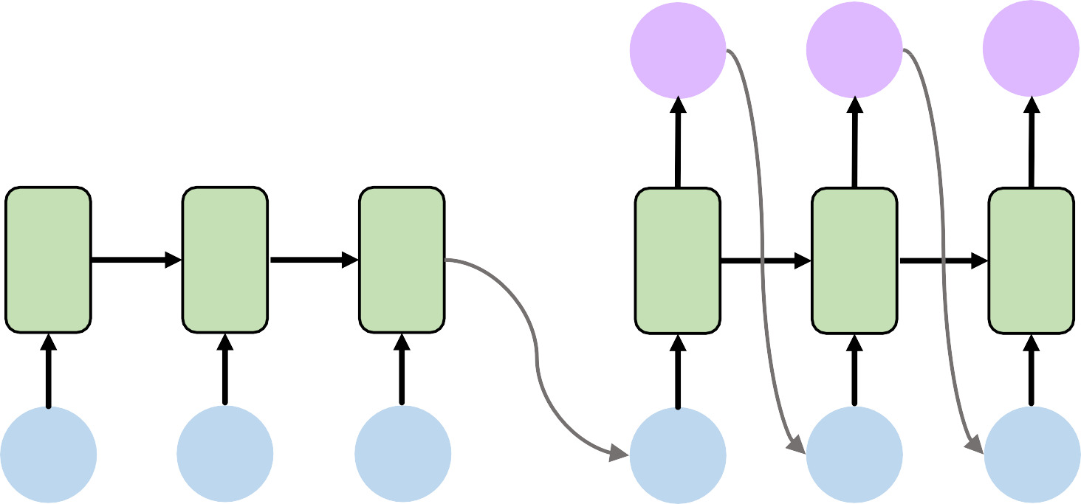
Example task: machine translation
le
chien
mange
the
dog
eats
<start>
le
chien
Encoder (English)
Decoder (French)

Slide 90
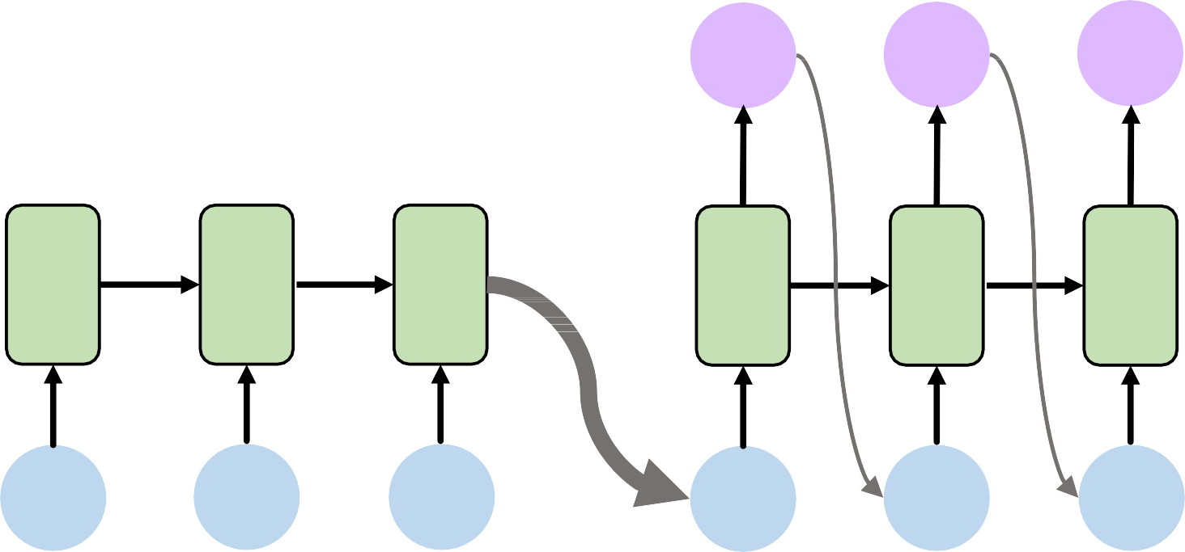
Example task: machine translation
le
chien
mange
encoding bottleneck
the
dog
eats
<start>
le
chien
Encoder (English)
Decoder (French)

Slide 91
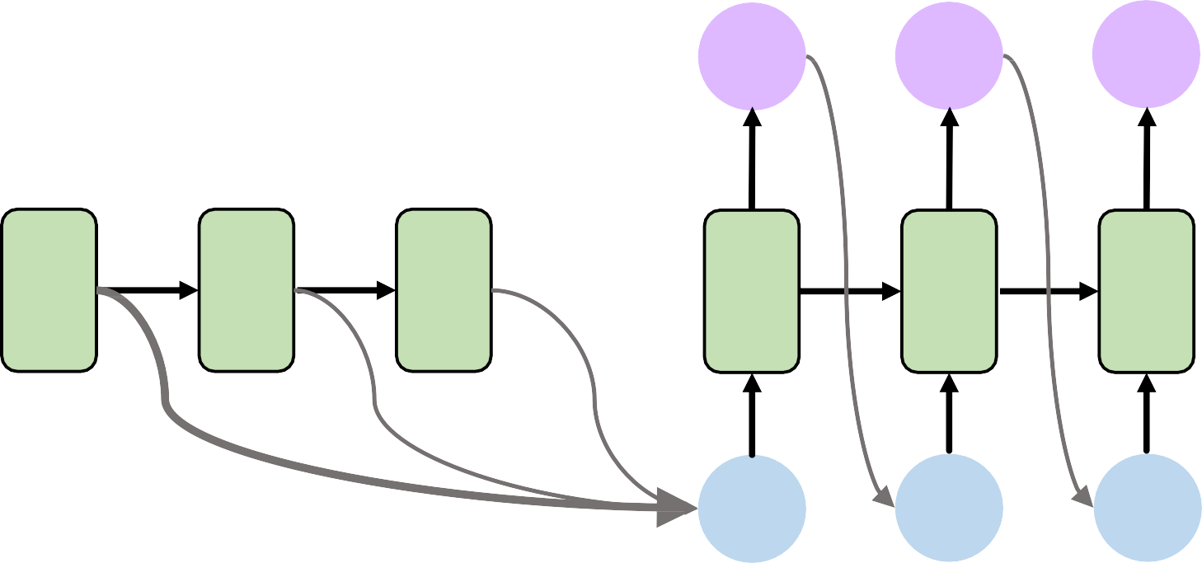
Attention mechanisms
le
chien
mange
Attention mechanisms in neural networks provide learnable memory access
the
dog
eats
<start>
le
chien
Encoder (English)
Decoder (French)

Slide 92
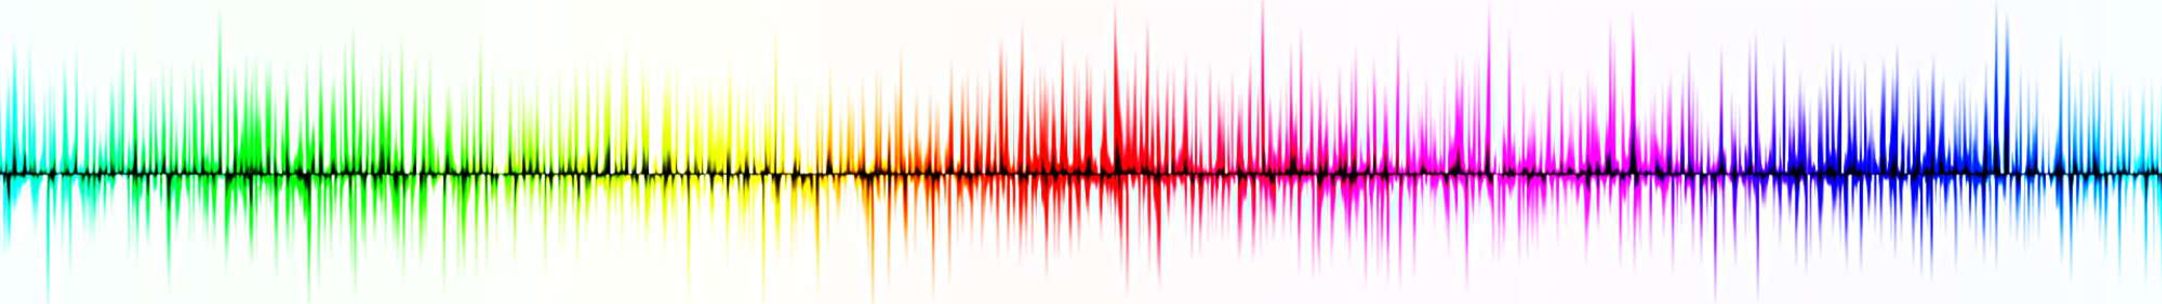
Recurrent neural networks (RNNs)
RNNs are well suited for sequence modeling tasks
Model sequences via a recurrence relation
Training RNNs with backpropagation through time
Gated cells like LSTMs let us model long-term dependencies
Models for music generation, classification, machine translation

